Slide 1
Case Study
AMA-Marketing Austria
Prague, 18. April 2018

Slide 2
Process and Timeline
Call and info session in Brussels
January 2016
Market research, preparation of the application and submission
April 2016
Accept and adopt the preparatory measures
November 2016
Implementation
Project duration three years

Slide 3
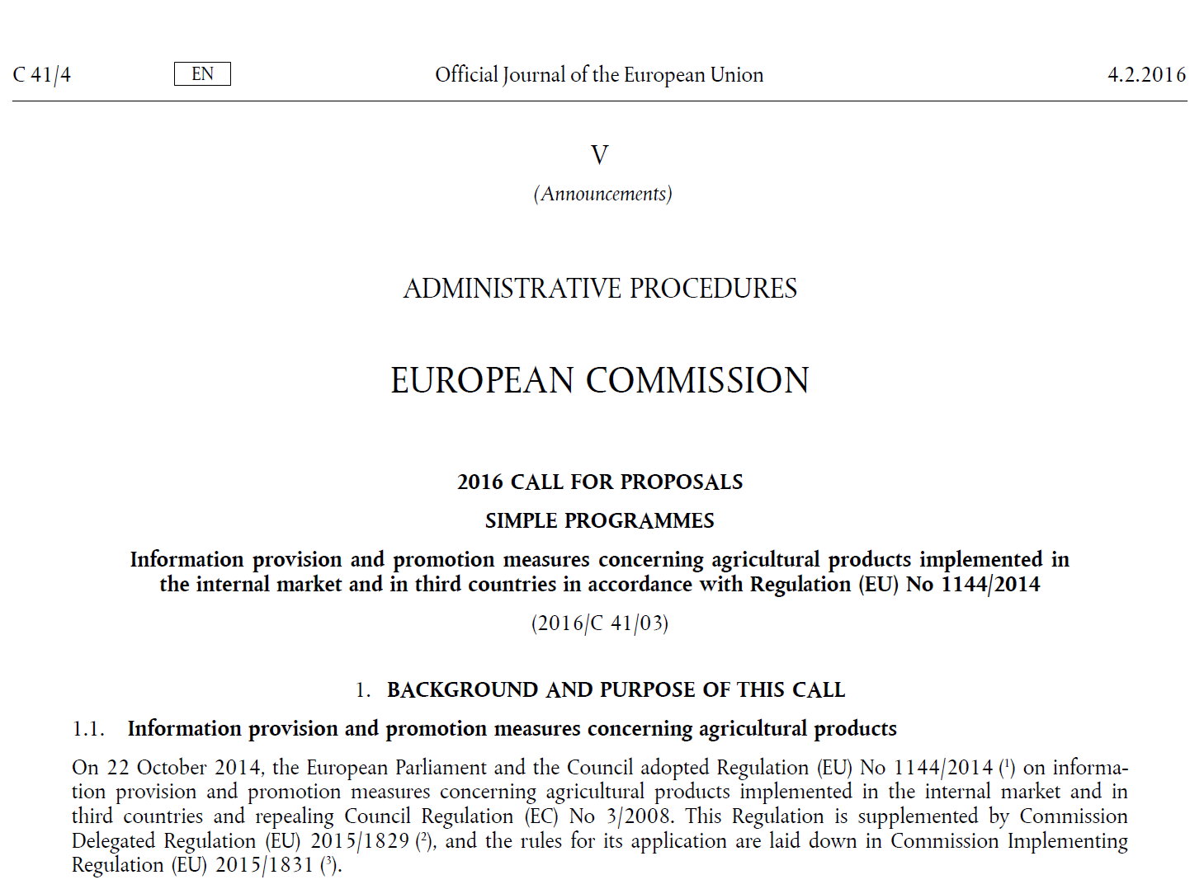
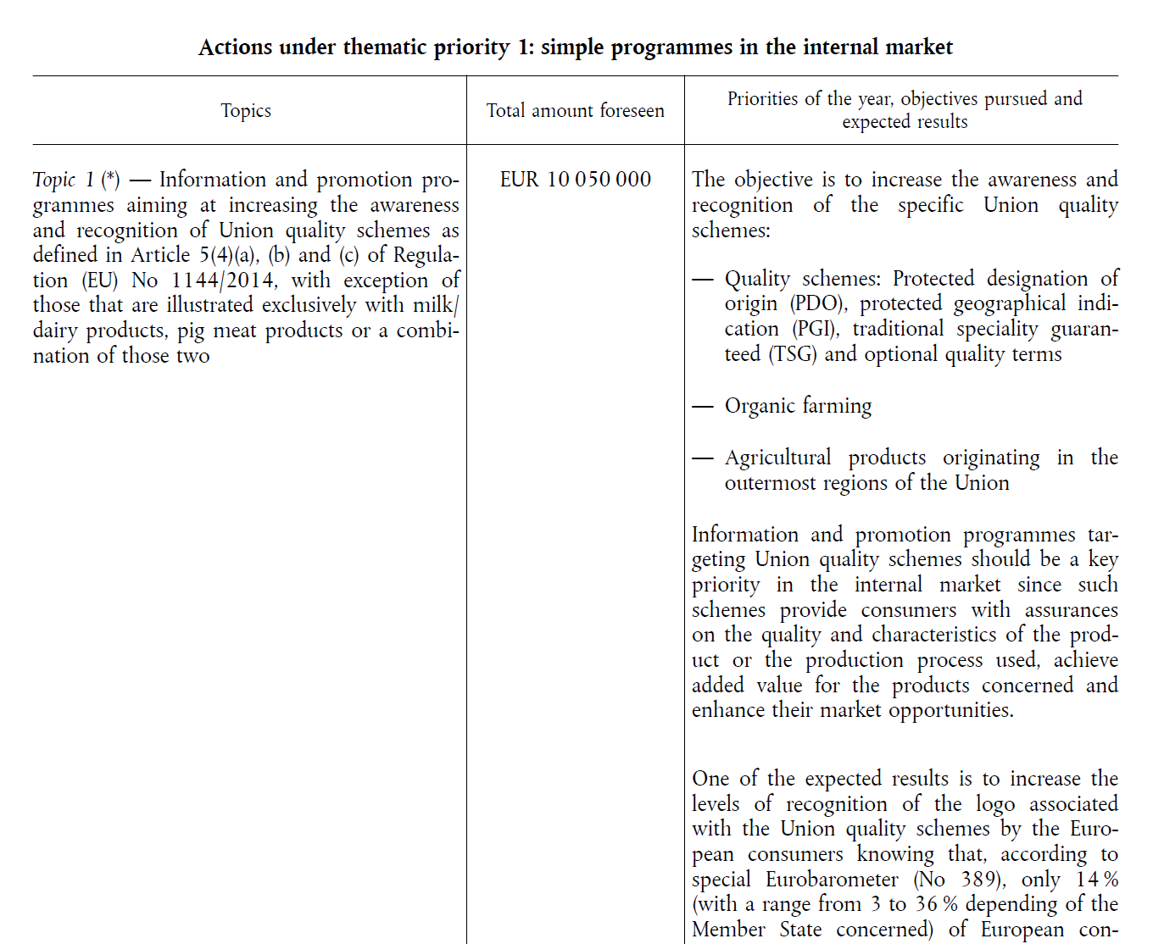
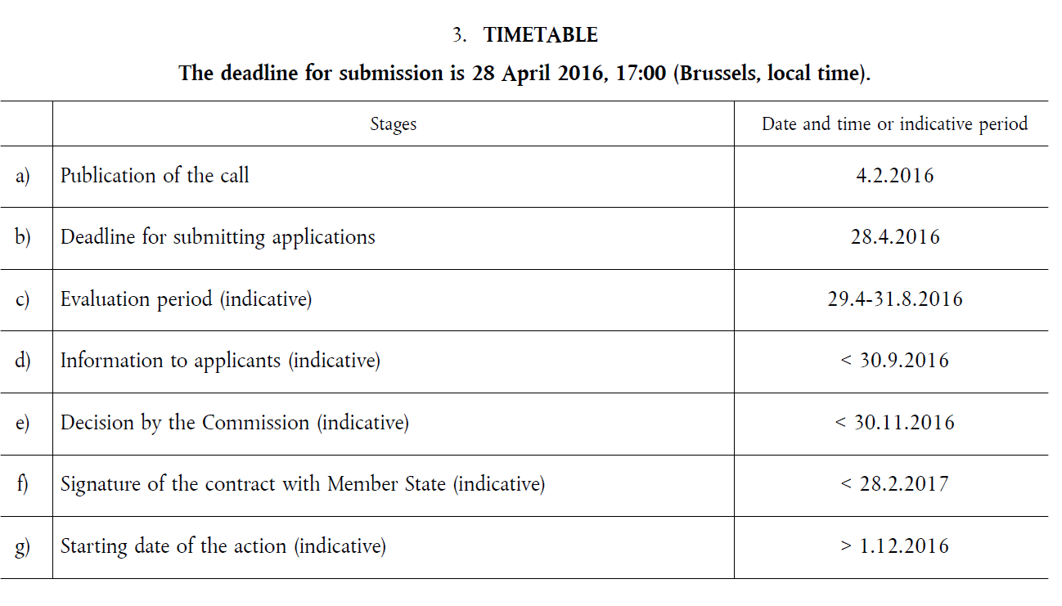
Call and Info-session
Notes:
Verfügbare Mittel
Wer darf Antrag stellen
Kofinanzierung 70 % und 80 %
Was kann gefördert werden (Maßnahmen)
Wie geht die Bewertung vor sich
Weiterführende Links zum Helptesk
Infosession in Brüssel Stick mit Anleitung bekommen, Webpage wurde vorgestellt etc.

Slide 4
Process and Timeline
Call and info session in Brussels
January 2016
Market research, preparation of the application and submission
April 2016
Accept and adopt the preparatory measures
November 2016
Implementation
Project duration three years

Slide 5
Market Research and
Preparation for the Application
Start brainstorming early enough and initiate the market research
If necessary use existing data (Statistical Federal office, Eurostat,…)
Choose an agency (information required)
Proposal writing approx. one working month
Proposal writing, similar to a thesis at University
Write the proposal in English or take into account the time needed for the translation
Organise documents for part A

Slide 6

MR and Proposal Preparation

Slide 7
Submission
Register in the submissions portal
Writing the proposal
  Presentation of the organisation
  Market analysis
  Goal setting (SMART)
  Develop the planned activities
  Explain the EU dimension of the activities
  Detailed description of the activities
  Set indicators to measure the results
  Assign and explain responsibilities (agency, own staff, etc.)
  Further information
Notes:
Nicht am letzten Tag einreichen – Technische Schwierigkeiten

Slide 8
Process and Timeline
Call and info session in Brussels
January 2016
Market research, preparation of the application and submission
April 2016
Accept and adopt the preparatory measures
November 2016
Implementation
Project duration three years

Slide 9
Approval and Preparation of the Activities
Be delighted
Inform the stakeholders
Take the critics into account
Estimate the costs of the implementation and employ the necessary resources (secretary, agency, etc.)
Set up a meeting with the national control body
Contract signing
Getting a step ahead – Can certain tasks be done before the official start date? (Preliminary work) Eg. Search for locations to film the videos, arranging incentives, getting to know the legal procedures, etc.

Slide 10
Process and Timeline
Call and info session in Brussels
January 2016
Market research, preparation of the application and submission
April 2016
Accept and adopt the preparatory measures
November 2016
Implementation
Project duration three years

Slide 11
Implementation
Only what is implemented can be submitted
Work closely with the agencies stated on the contract
Run the different activities elements approval through the control body (mandatory listings of the public funding reference).
Structured documentation in all procedures
Costs control
Every invoice can only be submitted for one funded project (mandatory reference in every invoice)
Assigning an auditor

Slide 12
Current EU-Project in the AMA-Marketing within the Export department

Slide 13
Key Data
Promotion of the EU labels with focus on milk products that carry the EU quality logos.
Program length 1.3.2017-28.02.2020
Budget composition: 70% from EU funds, 30% from the AMA Marketing „Milk“ department budget.

Slide 14
Findings of the Market Research – quantitativ
Germany is the most important export market for Austrian milk products, where cheese consumption per capita is around 24kg.
Focus on supermarkets and hypermarkets.
Focus on the cheese counter because that’s where the highest added value is.
Sliced and hard cheese are the highest consumed (most bought) cheese types in Germany.
Hard cheese is the cheese type with the highest growth.
The export increase of Austrian cheese is the highest in comparison to all other export products carrying the EU quality labels.
Nations with a variety of EU-protected cheese types achieve the highest own added value.

Slide 15
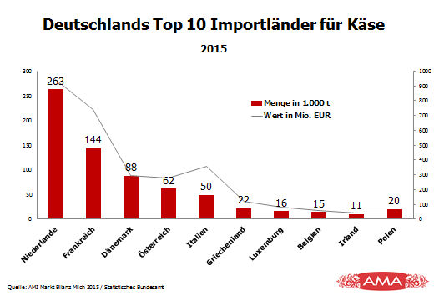
Findings of the Market Research – Quantitativ
Germany‘s Top 10 cheese Import countries 2015
Table below showing the different EU countries volume of cheese sales with protected origin.
 | Anzahl | 2005 | 2010
Italien | 36 | 2.847.933 | 3.426.053
Frankreich | 46 | 1.306.021 | 1.570.747
Spanien | 23 | 160.794 | 186.217
Niederlande | 4 | k.A. | 90.326
Österreich | 6 | 81.024 | 89.457
GB | 13 | 96.401 | 86.996
Deutschland | 4 | 40.180 | 49.600
QUelle: AMI Markt Bilanz Milch 2015/Statistisches Bundesamt
Quelle: ec.euopa.eu. Agricultural products and foodstuffs – PDO and PGI – Reg. (EC) No 510/2006 Cheeses

Slide 16
Market Research findings – qualitativ
German consumers tend to check more the origin of the food.
The importance in animal welfare, sustainability and the absence of genetic engineering is increasing.
The EU quality labels are not very well known, within the seals, the most commonly used is the PDO
Very few customers take into account the labels when purchasing. However, the results from a survey show that 69% of the consumers are willing to pay more for protected origin and protected quality products.
Notes:
Umfrage über die Bekanntheit der Qualitätssiegel wurde von uns beauftragt und durchgeführt

Slide 17
Objectives
Goal 1: Raise awareness of the EU- Quality label
Goal 2: Promote the discourse on European regional specialities, that carry the EU quality seal and are therefore exquisite and exceptional.
Goal 3: Appreciation of the value of agricultural products.
The following goals should primarily focus on an information yield regarding food quality. As well as the adopted measures which should change the way of consumption and therefore improve the value added and the entire sector.
Notes:
Ziel 1: immer
Ziel 2: sachlicher Zugang
Ziel 3: emotionaler Zugang

Slide 18
Activities Strategy
Target groups
  Consumers (Gourmet, quality conscious)
  Opinion leaders (Journalists, Bloggers, Consumers via Social Media)
  Decision makers (priority purchase, distribution, Marketing)
Different channels will be selected and will be used in combination in order to reach the chosen target groups in different moments and with different aims.

Slide 19
Activities – Yearly
POS Activities
Mailings and Print
Cooperation with food bloggers
Online (Web and Social media)
Trade Fair
Product presentation
Photo exhibition / Art Project
Workshops/Round Table with specialists and journalists
Production of a virtual reality training video

Slide 20
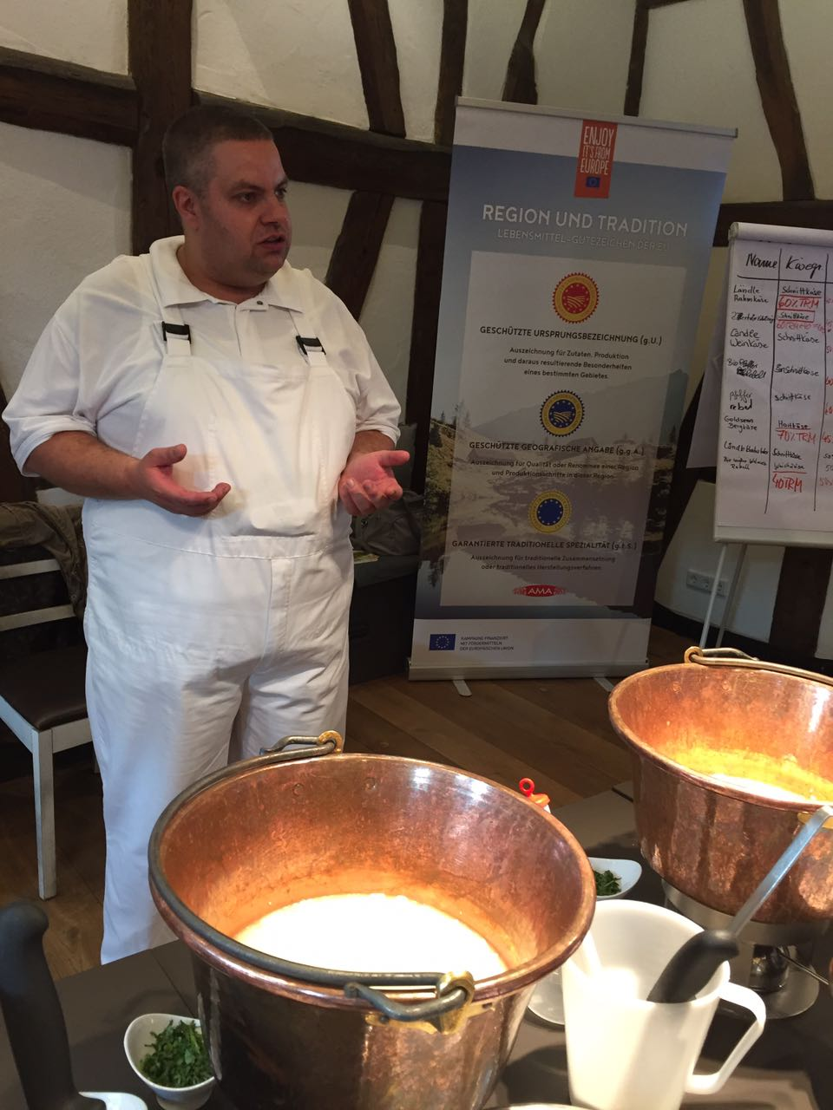
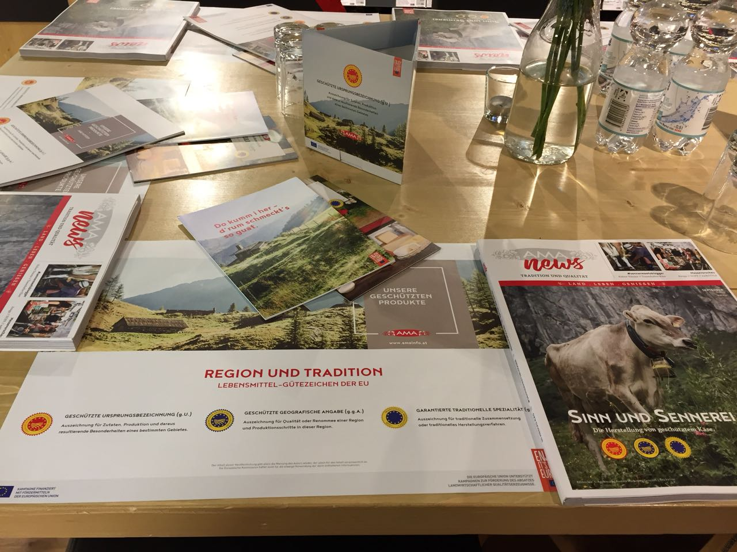
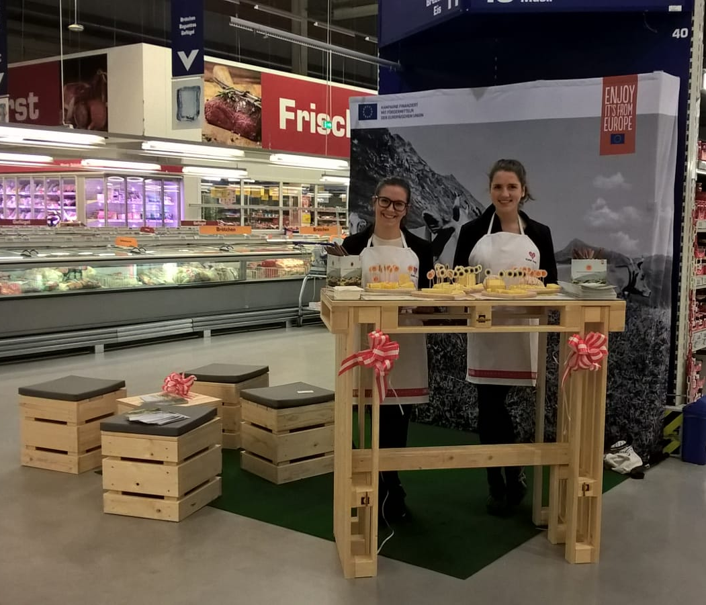
POS activities

Slide 21


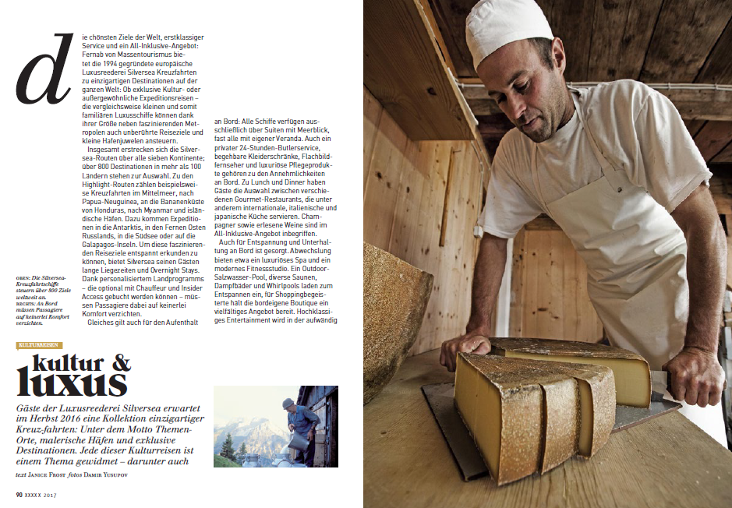
Mailings and Print

Slide 22
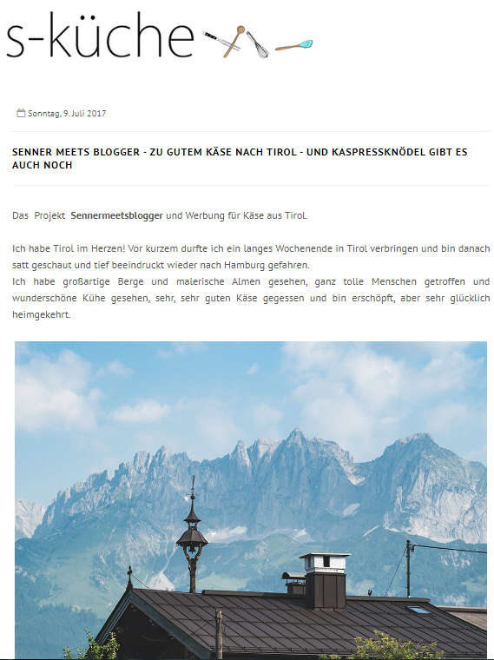

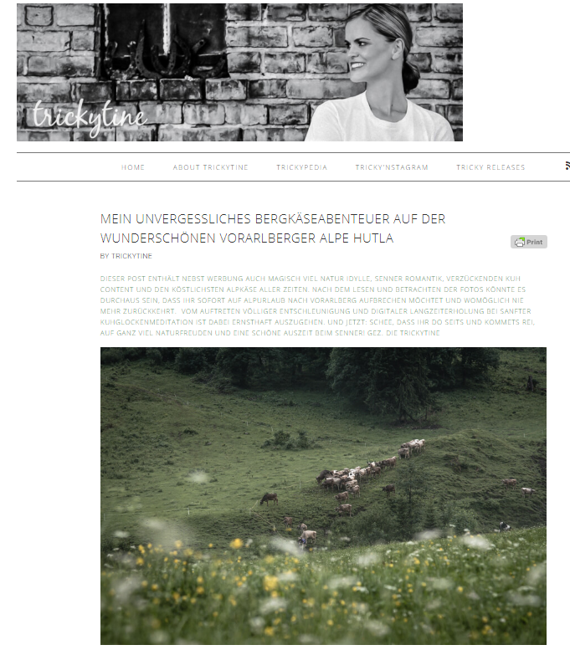
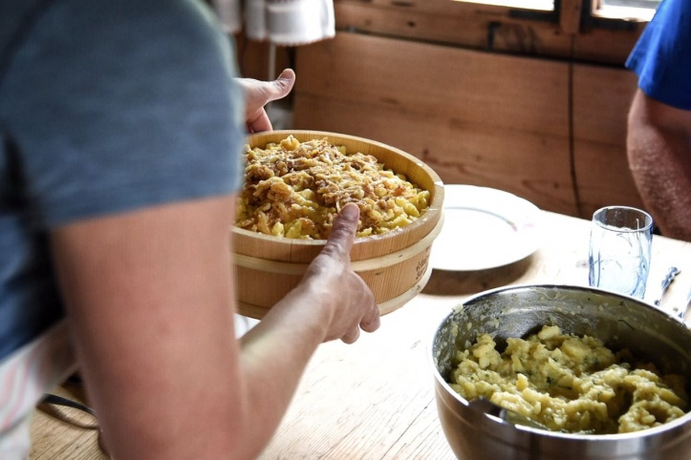
Cooperation with Food Bloggers

Slide 23
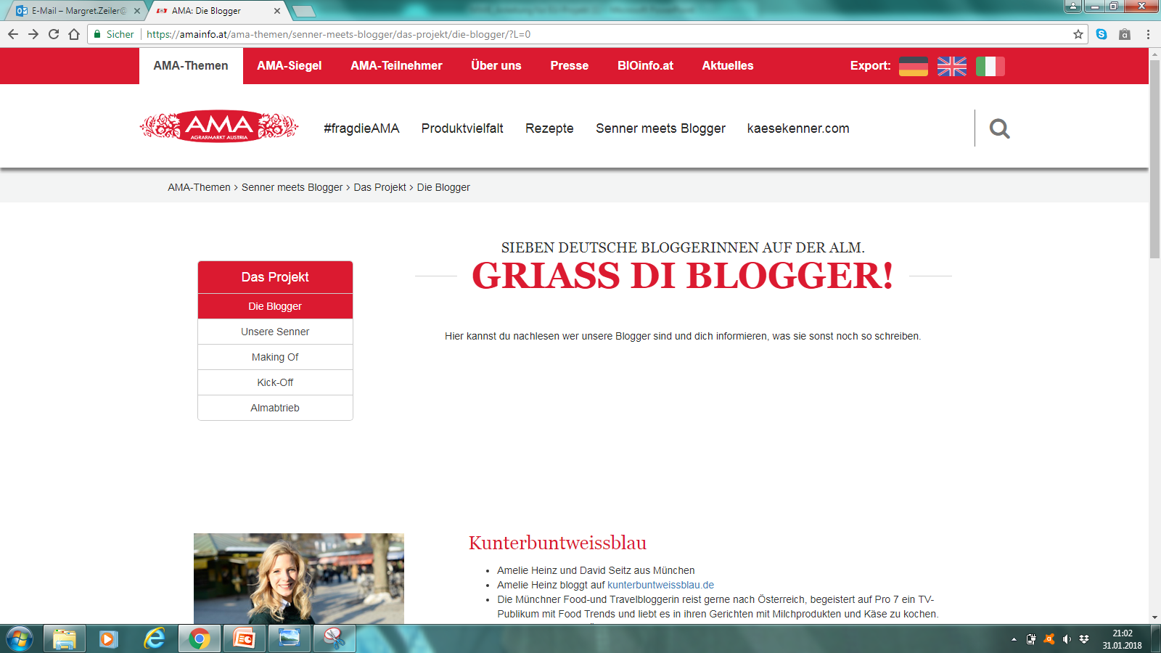
Online

Slide 24
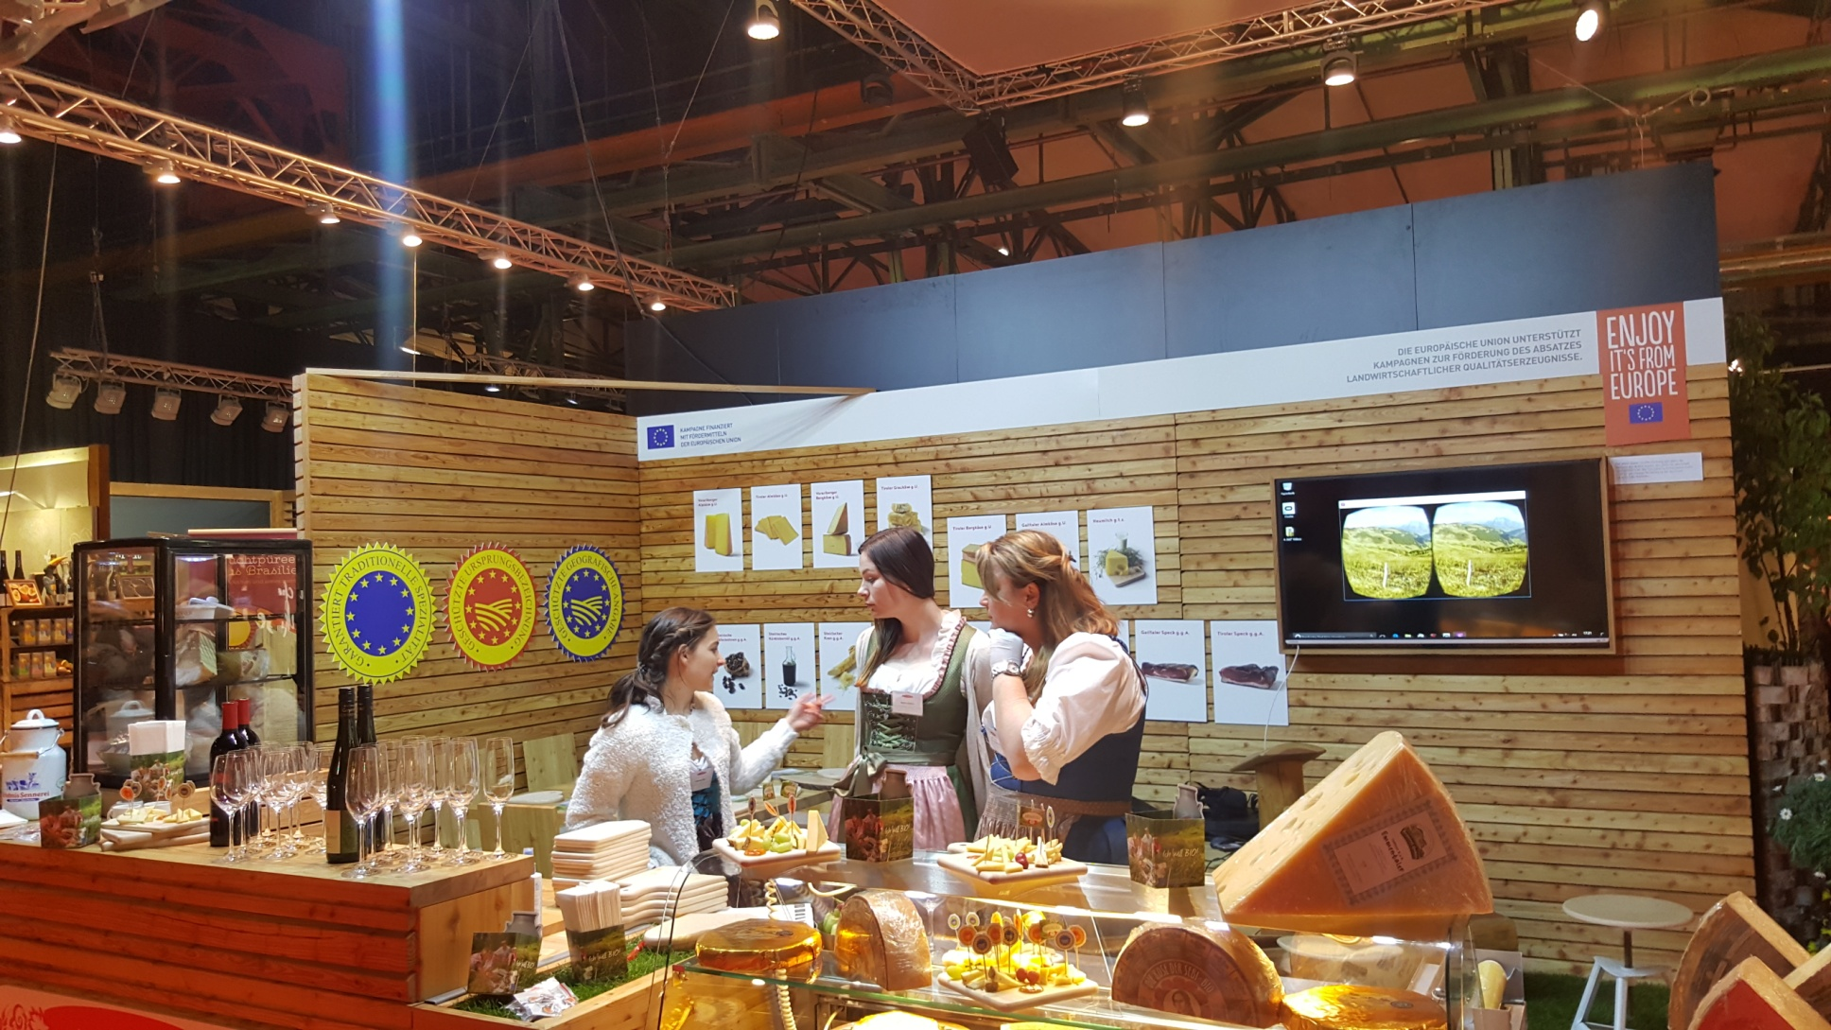
Trade Fair – Symposium Feines Essen und Trinken

Slide 25
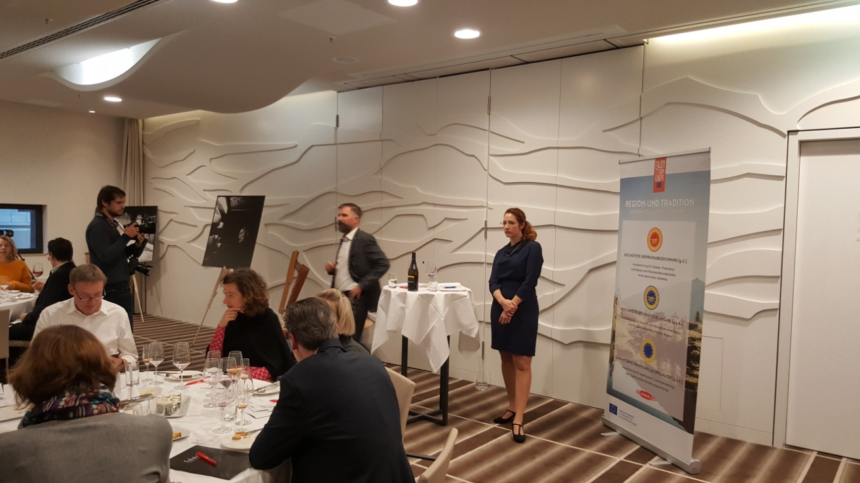
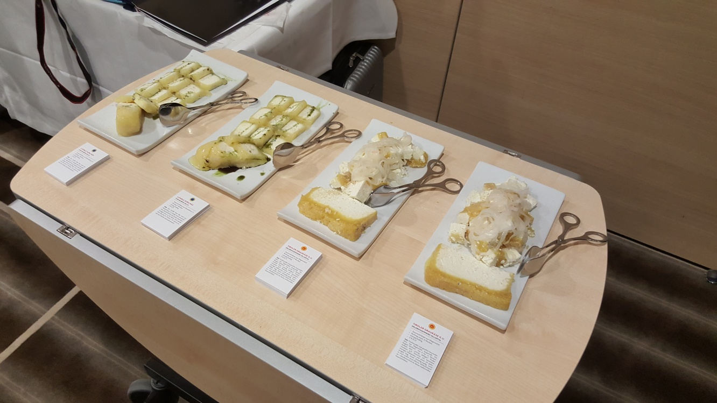
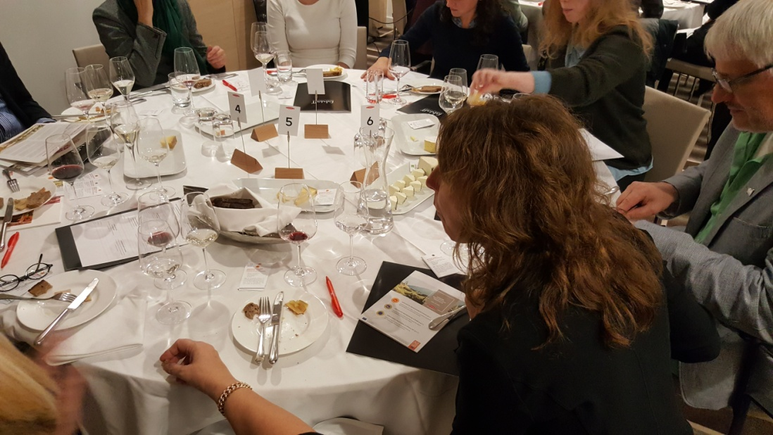
Product Presentation

Slide 26
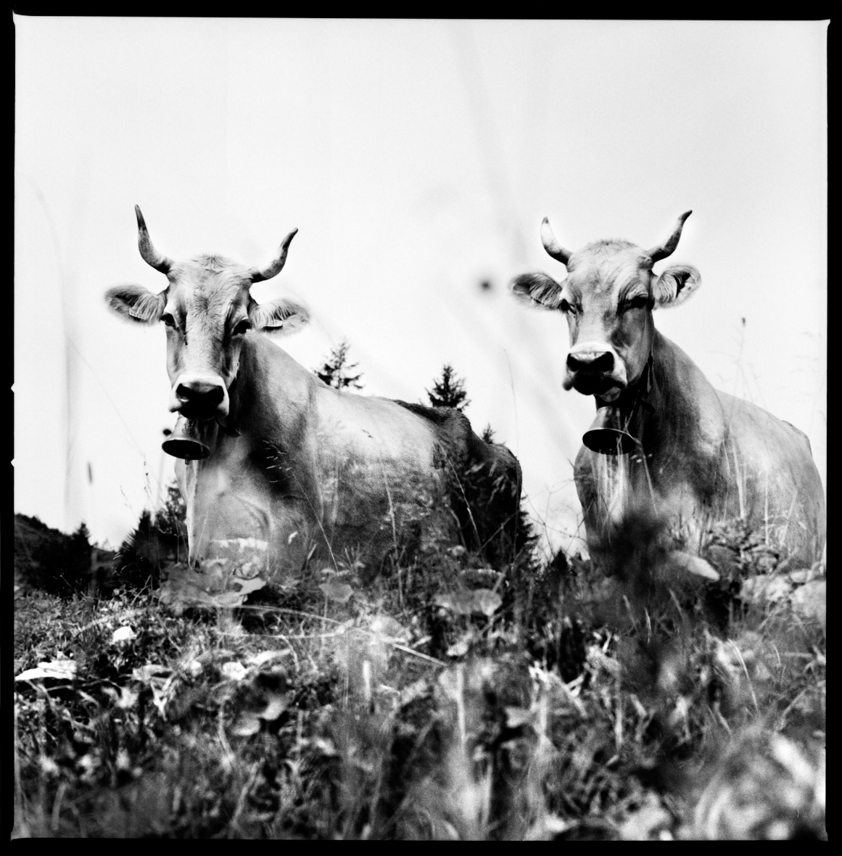
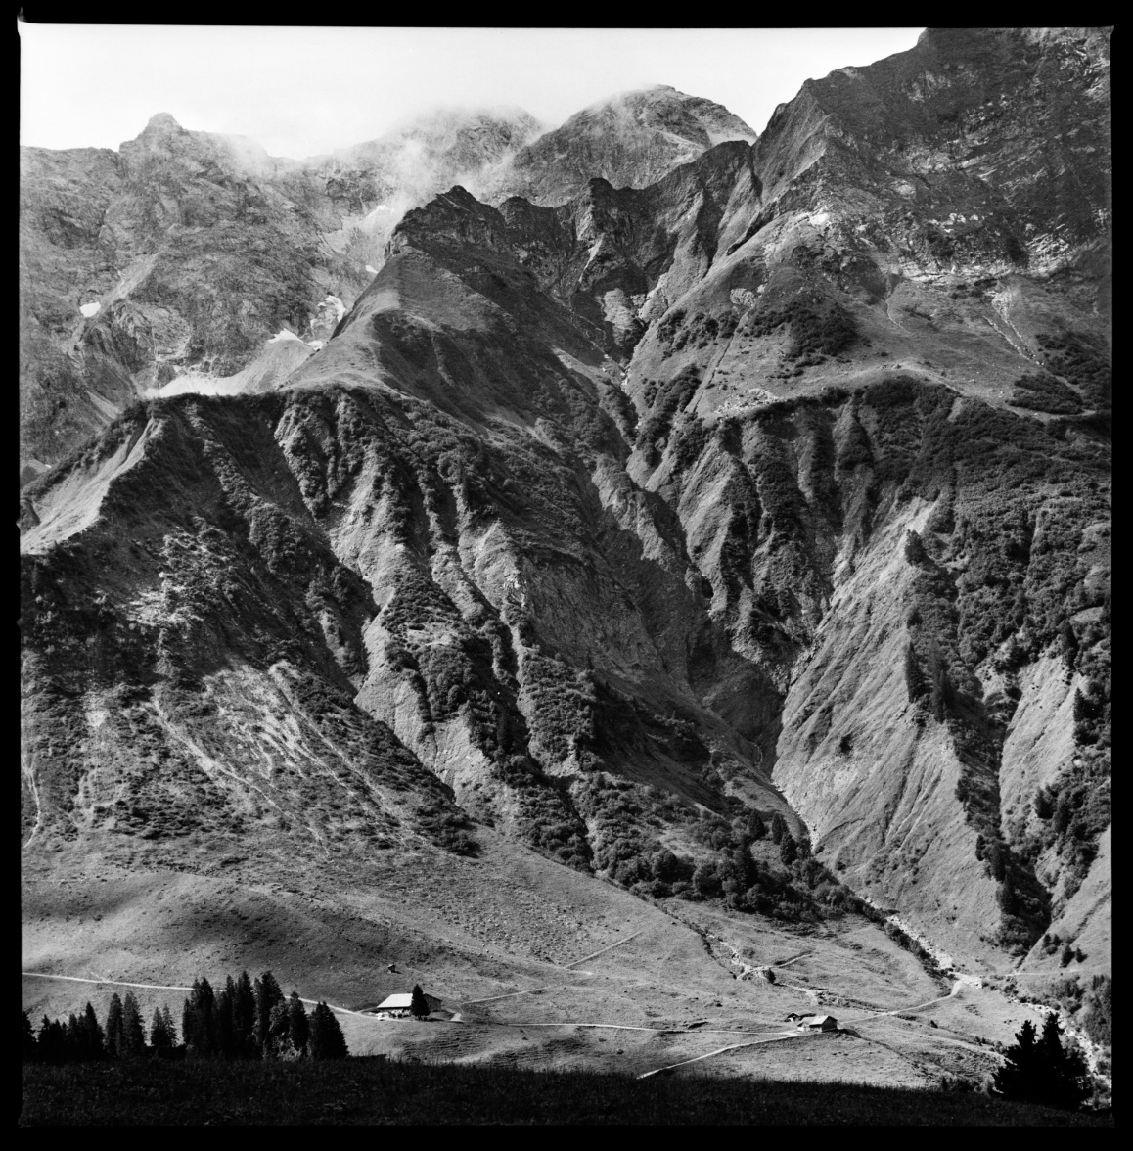
Art Project

Slide 27
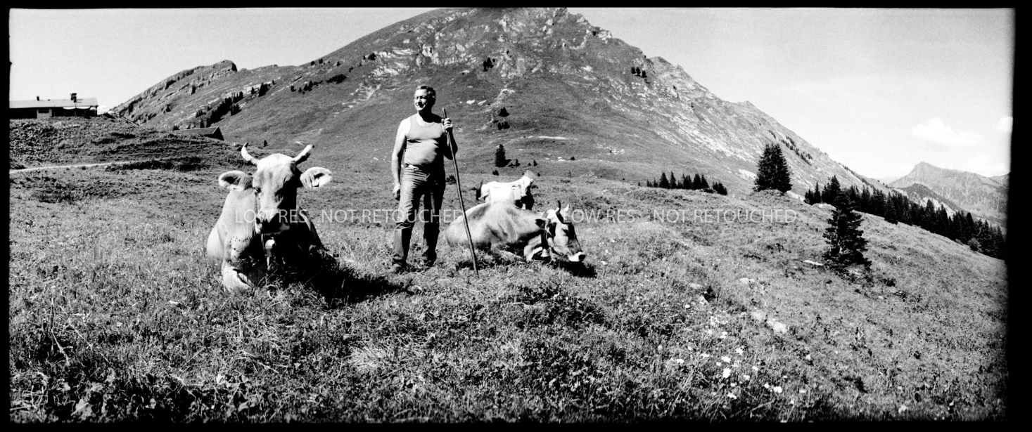
Art Project

Slide 28
EU-Dimension of the activities
Promotion of the EU quality regulations will rise awareness increasing the attention for all products bearing these labels.
Production methods and the advantages of the European Union Agricultural products are being explained.
The discourse on the eating culture, food safety, origin, traceability, animals and environment protection, sustainability, diversity and tradition will be stimulated. Resulting in an awareness towards the European products.

Slide 29
FAQ
What is the EUs aim?
  Strengthening the competitiveness of the agricultural sector of the Union.
  Demonstrate the high standards and advantages of the Union products.
  Improve the image of the specific characteristics from agricultural products.
  Recognition of the quality regulations.
  Increase the consumption for agricultural products.
Ineligible costs
  Costs must have actually incurred
  Financial transactions costs
  Always consider the economy

Slide 30
FAQ
Liquidity
  Advance payment at the beginning of the project.
  Financial closure at the end of each project year.
  A structured documentation and financial reporting should speed up the process.
Proved
  Activities will be reviewed throughout the project.
  Invoices will be checked at the end of every individual project year.
    Auditors
    Control authorities
  Between every individual project year and final report.

Slide 31
FAQ
Content
  Videos, photos, material etc. produced throughout the EU-Project can be further used once the EU-project has come to an end.
  Content can be provided to third parties (with the limit of individual promotion)
  Brands/company logos can be presented under certain circumstances (trade fairs, at least five companies)
  The funding authority should always be cited (graphic hand book)

Slide 32
Contact
Margret Zeiler
Managerin Exportmarketing
AMA-Marketing GesmbH
Dresdner Straße 68a
1200 Wien
+43 (1) 33 151 - 406
margret.zeiler@ama.gv.at
www.amainfo.at

